Slide 1
Projekt im Bachelor: MAPC
3. Milestone
Team: JNY Nader Jawhary, Yamen Sahyouni, Joakim Vik Haukedal
16.12.2021
Notes:
1

Slide 2
Brief Overview
Spiralling movement + finding task
Accepting tasks
Completing tasks
Remembering POIs
Dispenser, taskboards/goal

Slide 3
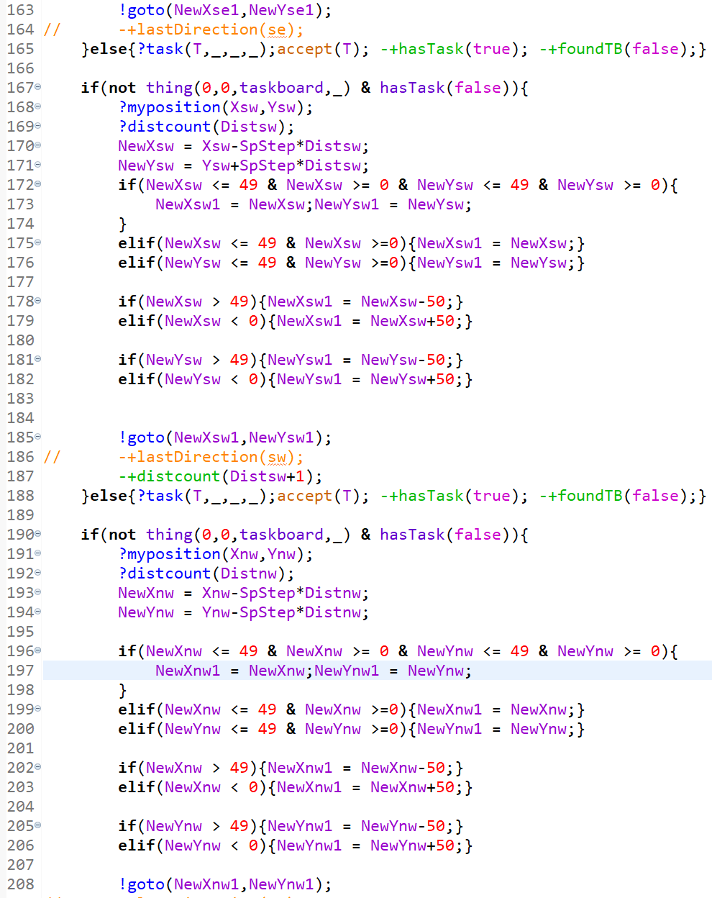
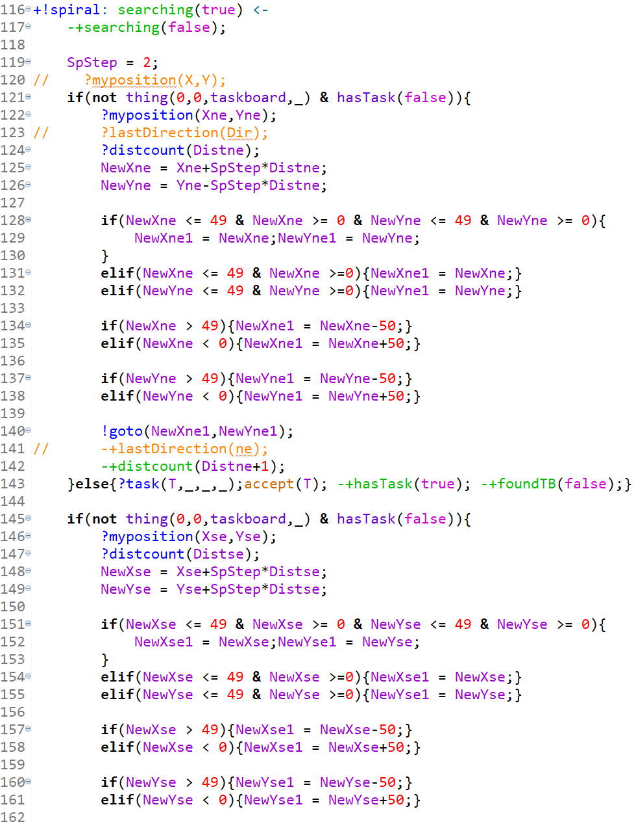
Code

Slide 4
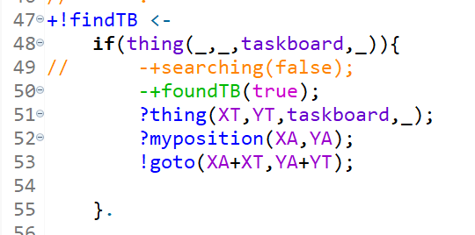
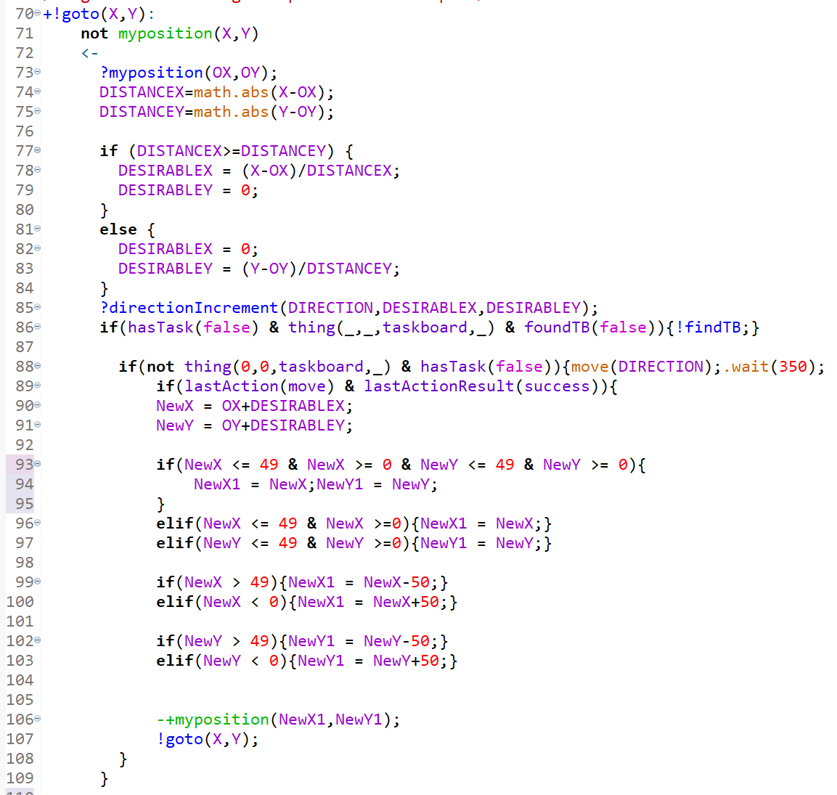
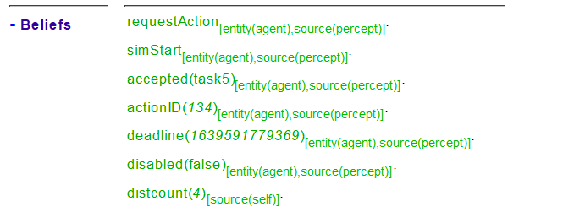
Code

Slide 5
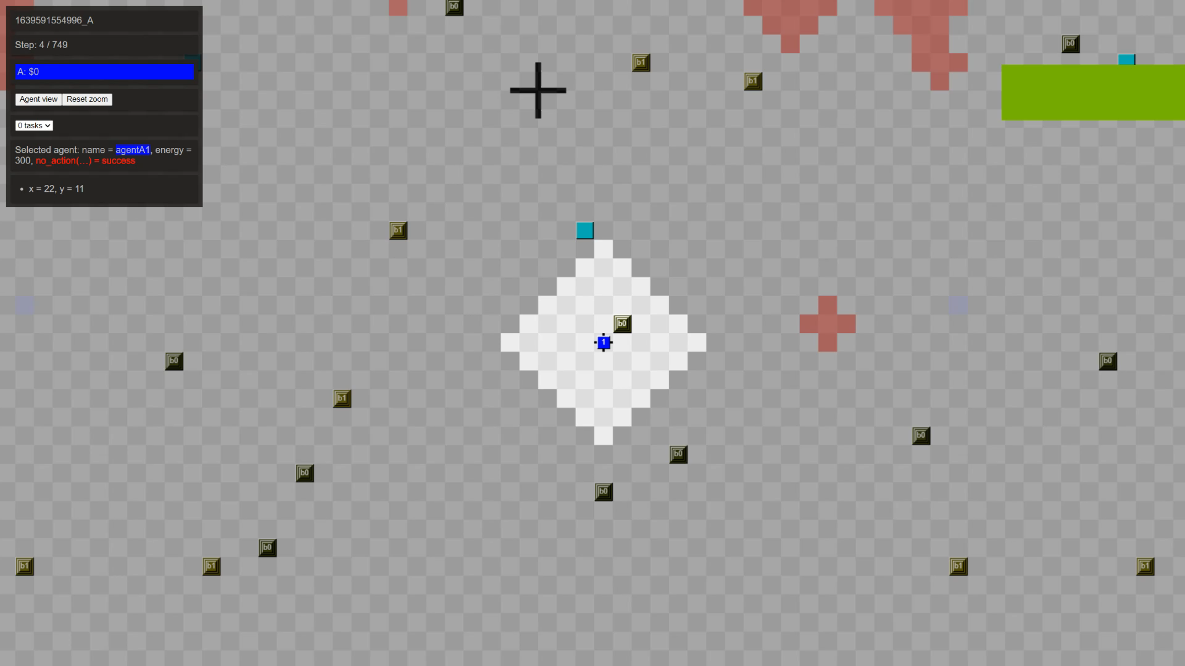

Slide 6
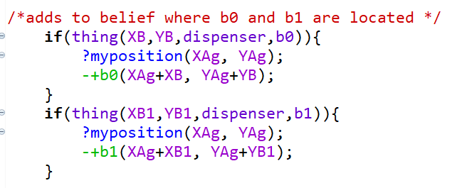
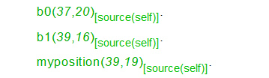
Code

Slide 7
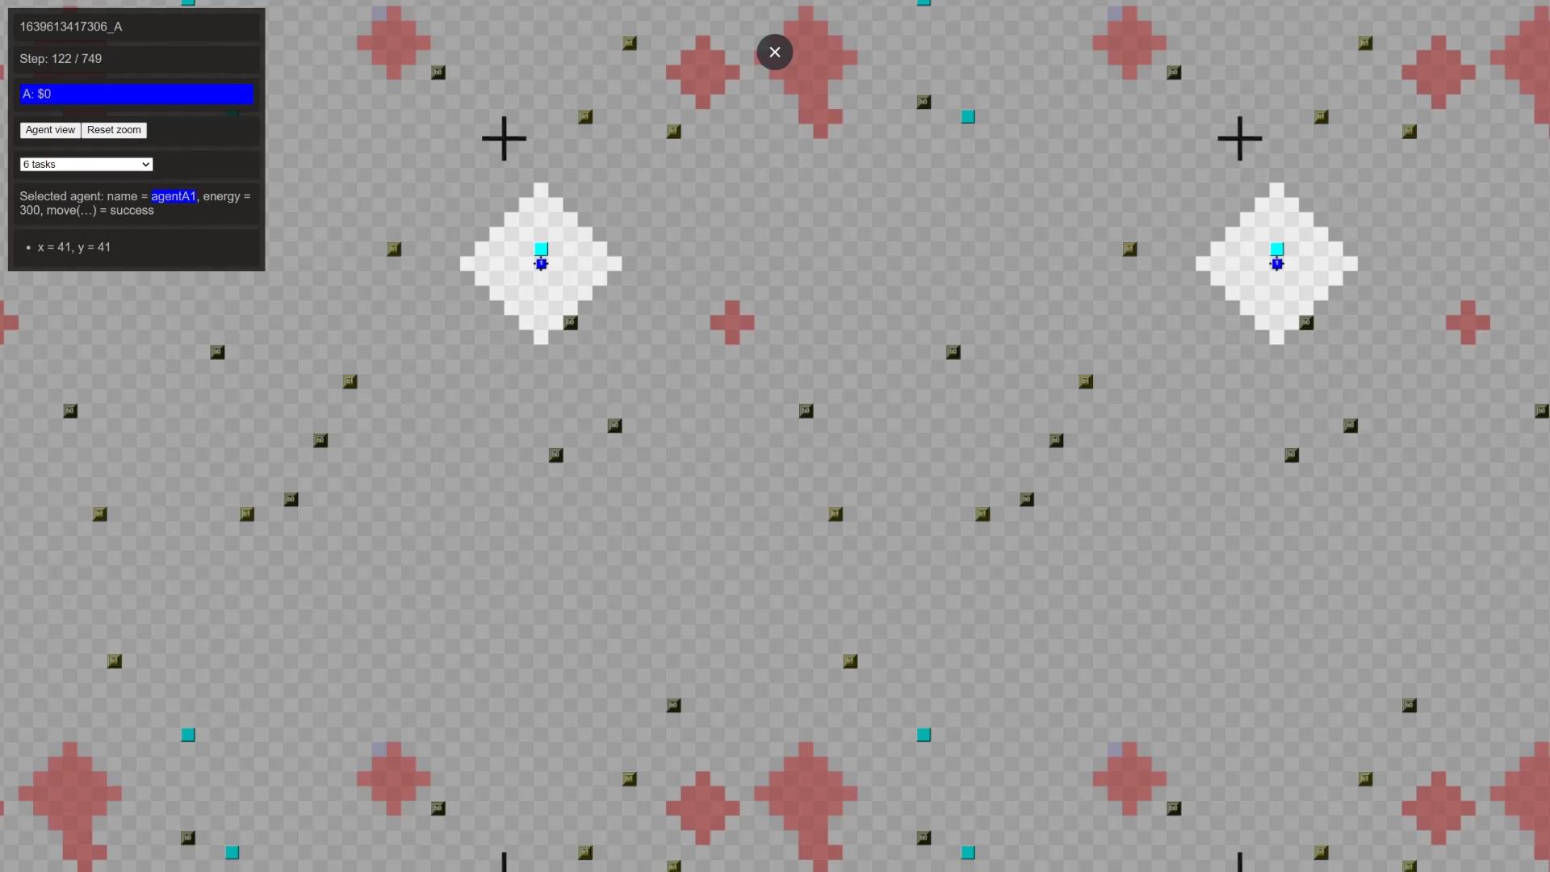

Slide 8
Problems
Running the program in normal mode, only works some of the time, but in debug mode it works (almost) every time
myPosition not working
Leads to the agent thinking it has a different position, than the true position
The agent “thinks” for several cycles without doing an action, afterwards it continues to work like normal
Not able to overwrite Variables

Slide 9
Future plans
Having multiple agents
Communication
Optimize task completion algorithm
Restructure Code to not use “.wait()”

